Slide 1

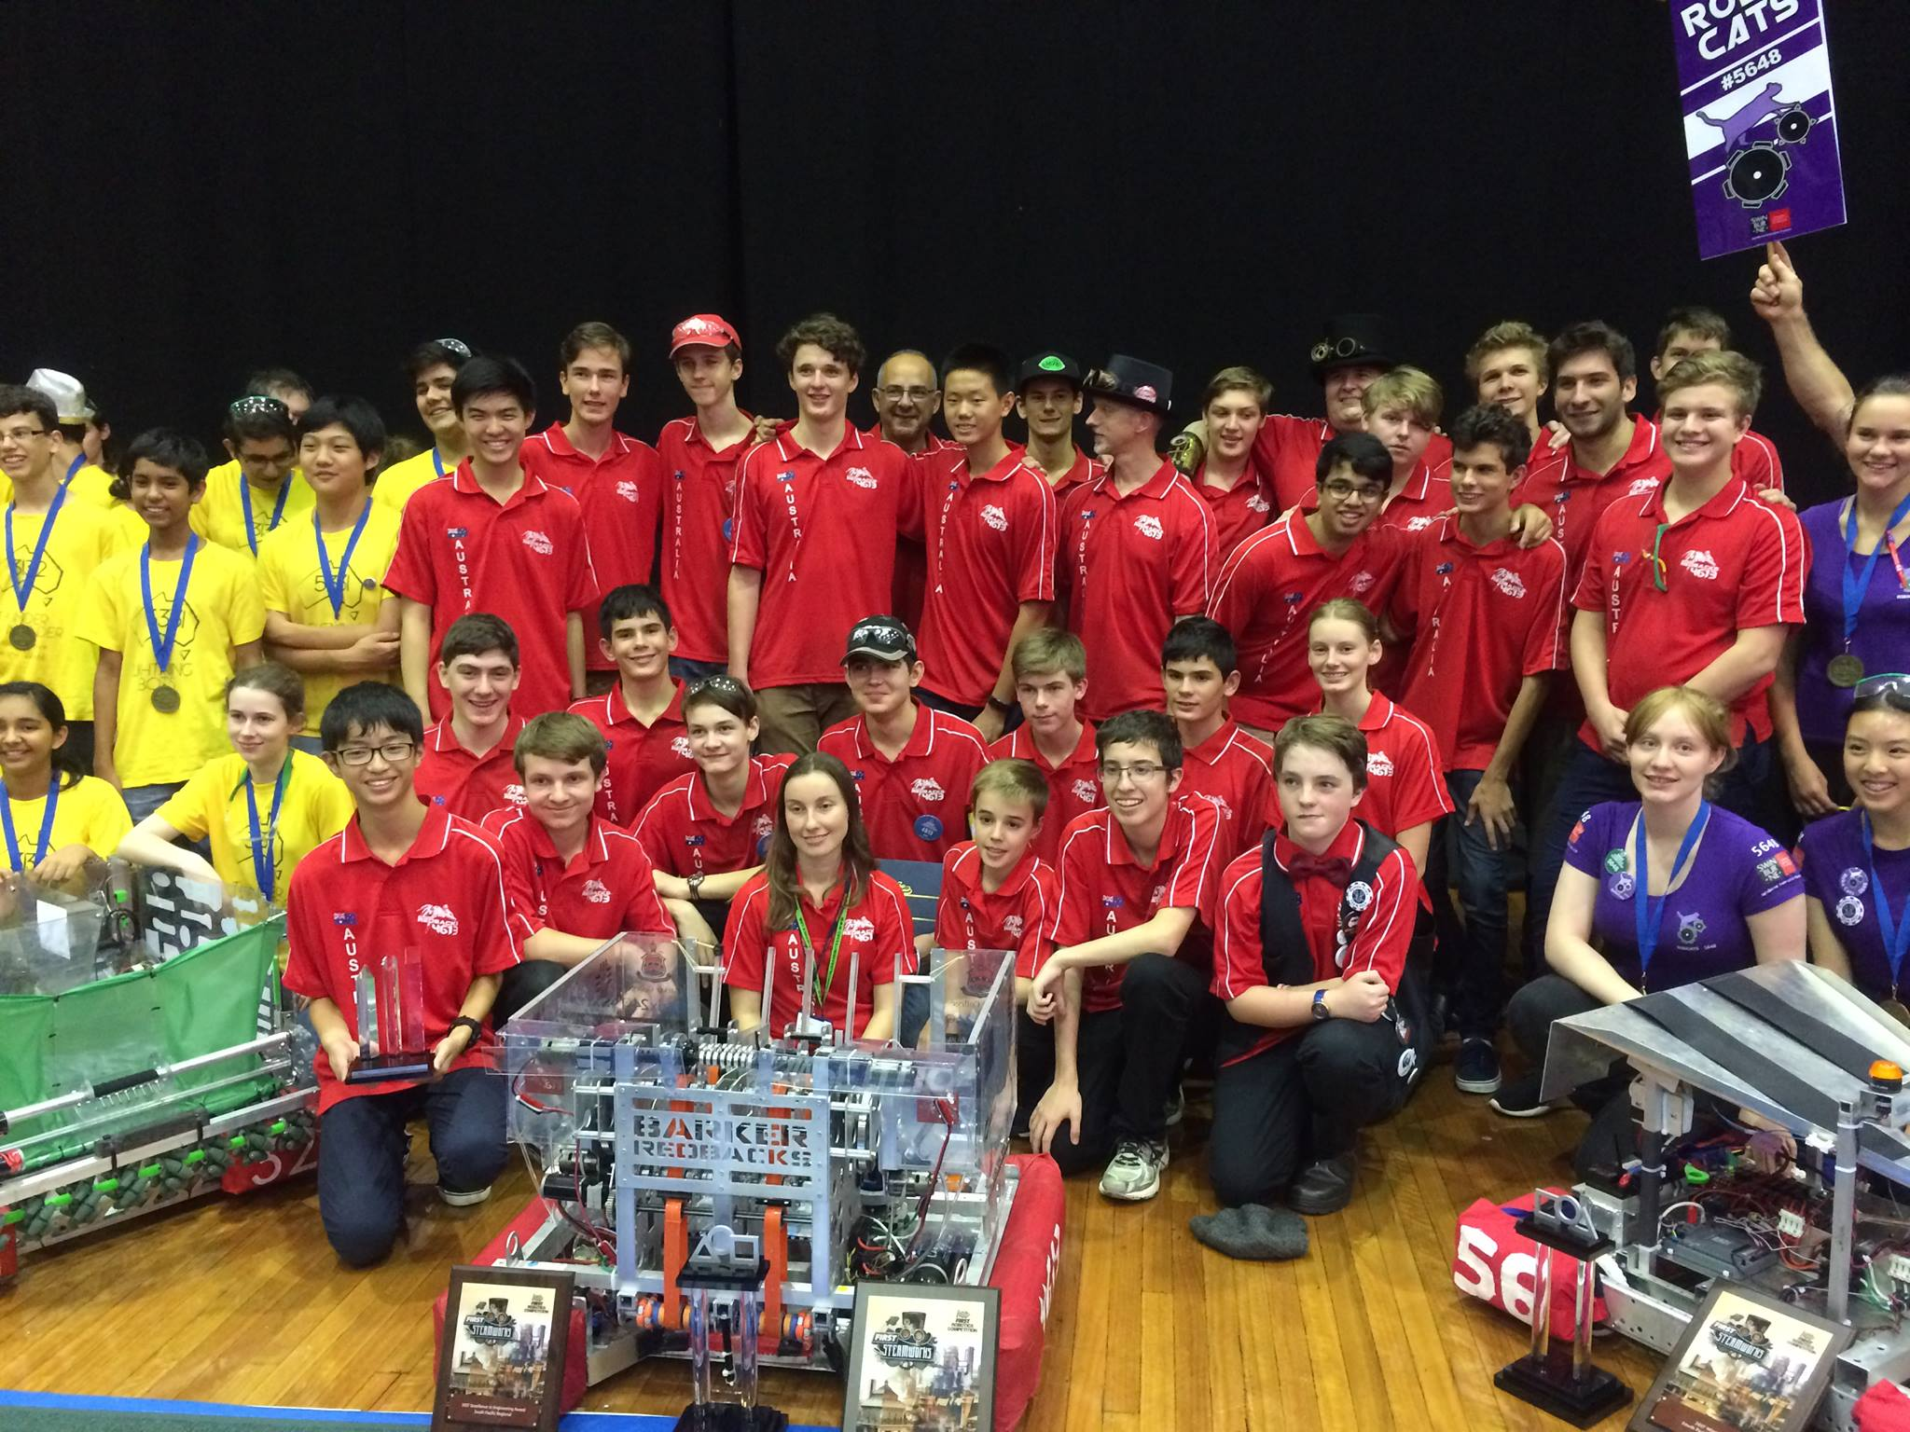
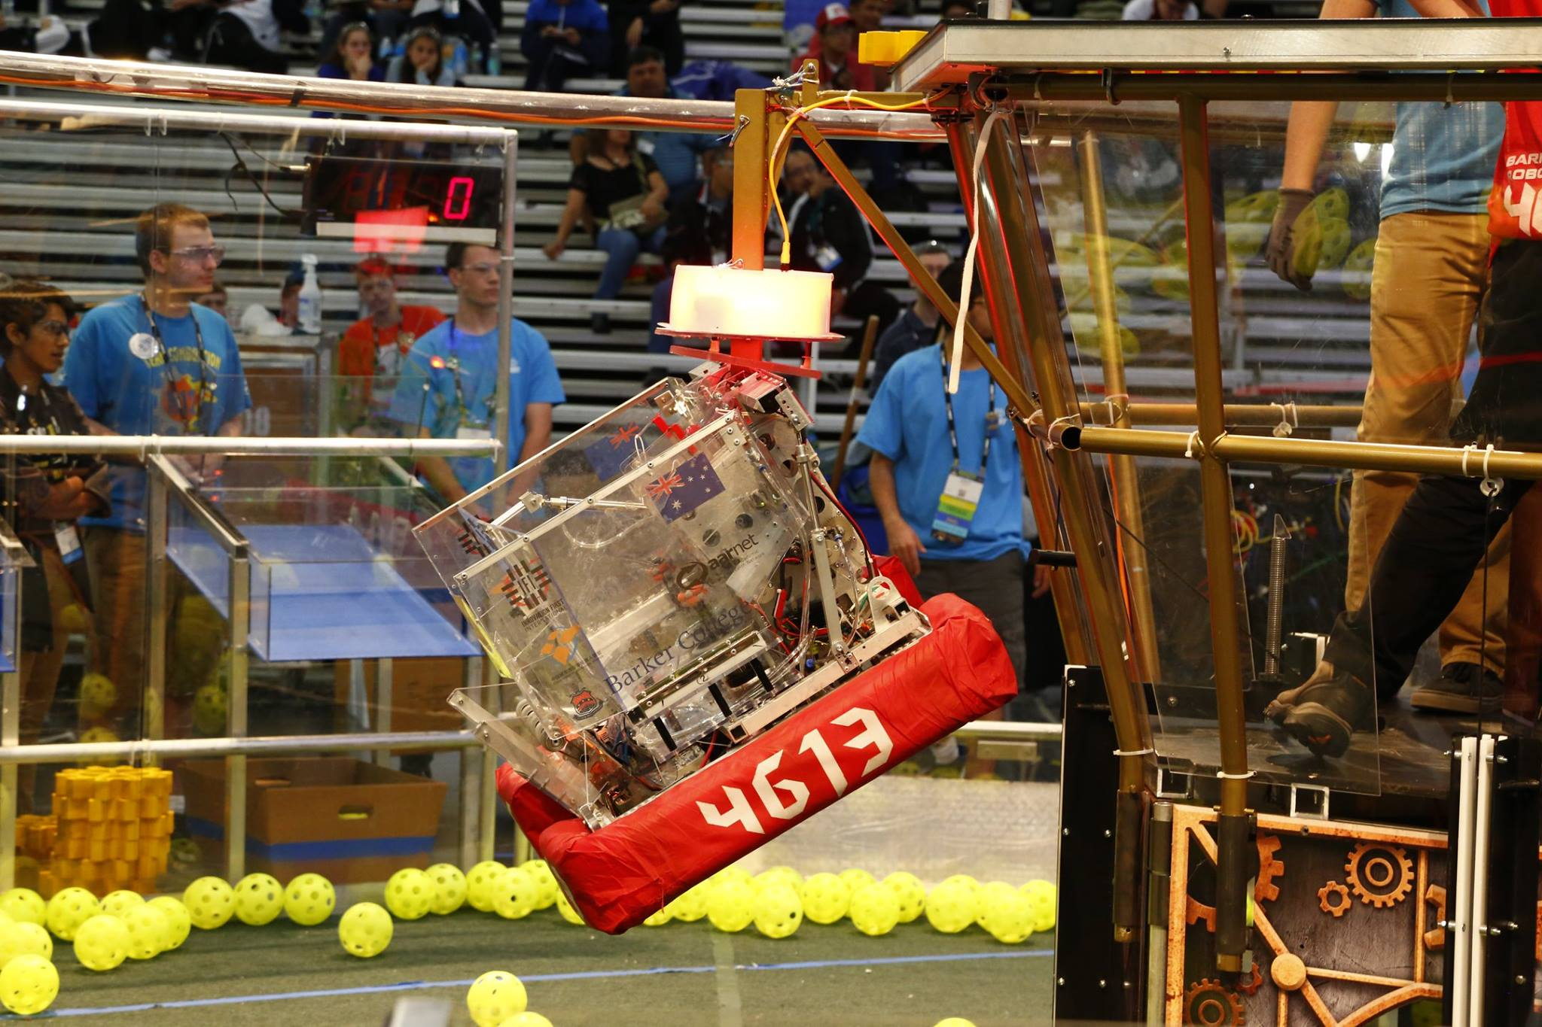
Introduction to (Java) Programming 10 - Algorithms
Tom Schwarz

Slide 2
Lesson 10: Algorithms
What is an algorithm?
An algorithm is a set of instructions to complete a task
For example:
Finding the door in a room: Check a wall. If it has the door, yay! If it dosen’t, repeat with the wall on the right.
Finding a book on a bookcase: Look through all books and check if it’s the right book
If you remember from last week, figuring out how to complete a task is an important step, before you actually program the computer to do the task
i.e. You need to figure out what you will tell the computer to do, before you tell it.

Slide 3
Lesson 10: Algorithms
Let’s try designing an algorithm!
How could we sort a random list of numbers to be ascending?
E.g. make [6, 3, 2, 84, 1] into [1, 2, 3, 6, 84]
Notes:
Think about:
How would we solve this manually?
Is this the fastest way?
Introduce big O to understand the time it will take to run, then explain how some algorithms are better than others.

Slide 4
Lesson 10: Algorithms – Designing algorithms
Think about the inputs & outputs of the algorithm
What data do you have to work with
What are you trying to achieve
Break down the problem into smaller segments
Think about how you would solve the problem on paper

Slide 5
Lesson 10: Algorithms
Selection Sort:
Loop through the list, find the smallest item and add it to a new list. Repeat.
Quick Sort (generally considered fastest sort):
Splits list into two, with one list containing upper half of numbers, other lower half. Then repeats…

Slide 6
Lesson 10: Algorithms
Insertion Sort:
Loop through the list, find the smallest item and add it to a new list. Repeat.
Quick Sort (generally considered fastest sort):
Splits list into two, with one list containing upper half of numbers, other lower half. Then repeats…
Insertion Sort Quick Sort Quick Sort (Slow so you can see)

Slide 7
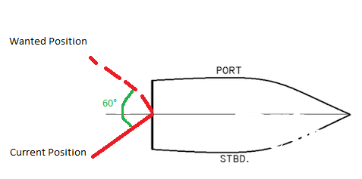
Lesson 10: Algorithms
Let’s design another algorithm!
Imagine we’re on a ship an we want to turn the rudder 60° (with a computer)
How should we do this?

Slide 8

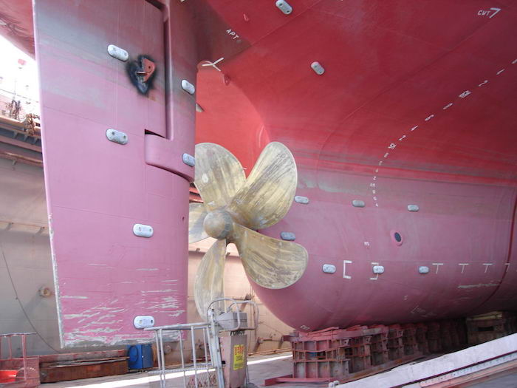
Lesson 10: Algorithms
Let’s design another algorithm!
Imagine we’re on a ship an we want to turn the rudder 60° (with a computer)
How should we do this?
However, we have an important limitation:
The rudder is very heavy, and has lots of momentum – it continues to turn a bit even after we stop turning it, and it takes a while to start moving

Slide 9
Lesson 10: Algorithms
PID
PID is a very common algorithm to solve this exact problem
PID takes an error (how far off the ruder is), and provides an output – say the energy to give to the engine.
PID has three parts:
P: Proportional – a proportional response to the error
I : Integral – a cumulative response to the error
D : Derivative – a predictive response to the error based on the rate of change
I is useful for fixing ‘steady-state-error’ – when the output (ruder) is slightly off, but not enough for P to manage to move it – I builds up in till it makes it move.

Slide 10
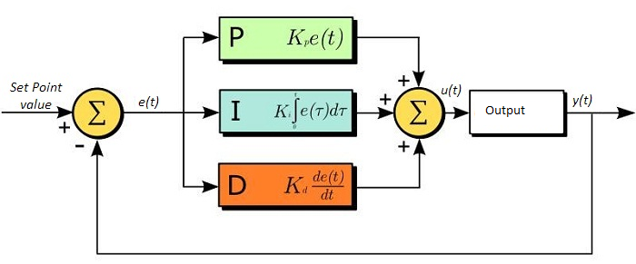
Lesson 10: Algorithms
The three sections (P, I & D) are summed together
However, before they are summed, each section is multiplied by a special value
These values are the three constants K_{p} , K_{I} & K_{D}
These values are different for every system, because each system responds differently – with different amounts of lag, momentum, units and energy
These values are found through the process of tuning – essentially trial and error

Slide 11
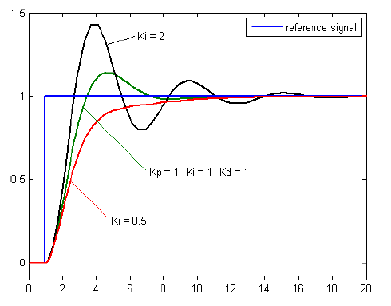
Lesson 10: Algorithms
Here we can see the three responses
P (Green) overshoots a bit but returns eventually
I oscillates around forever
D slowly approaches it
Combined the three responses work quite well

Slide 12
Lesson 10: Algorithms
PID is commonly used to control systems on the robot, to quickly get to a desired position
PID is also heavily used in industry
https://youtu.be/fusr9eTceEo
https://youtu.be/K-F_T59ZDPw

